Slide 1
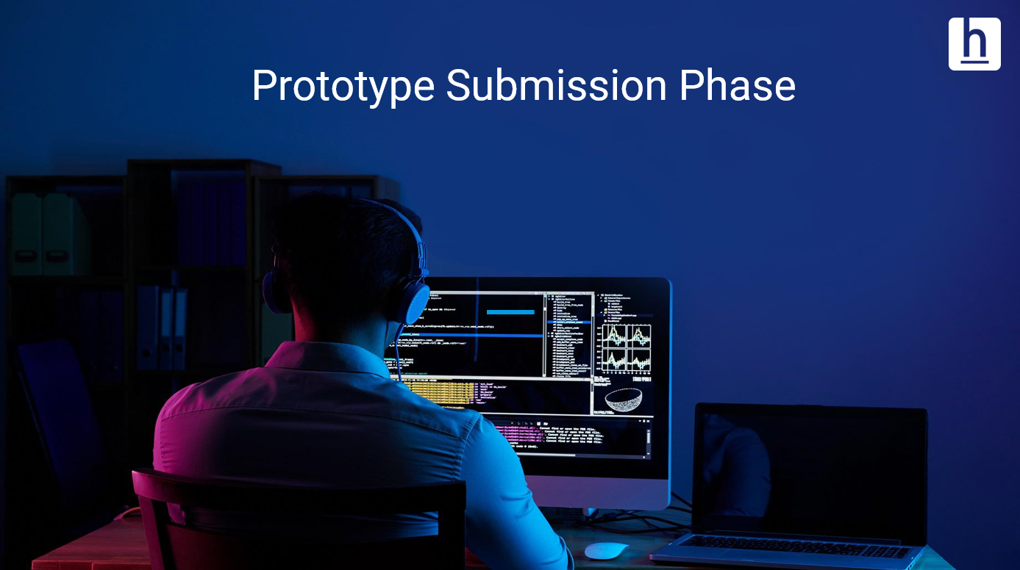

Prototype Submission Phase

Slide 2

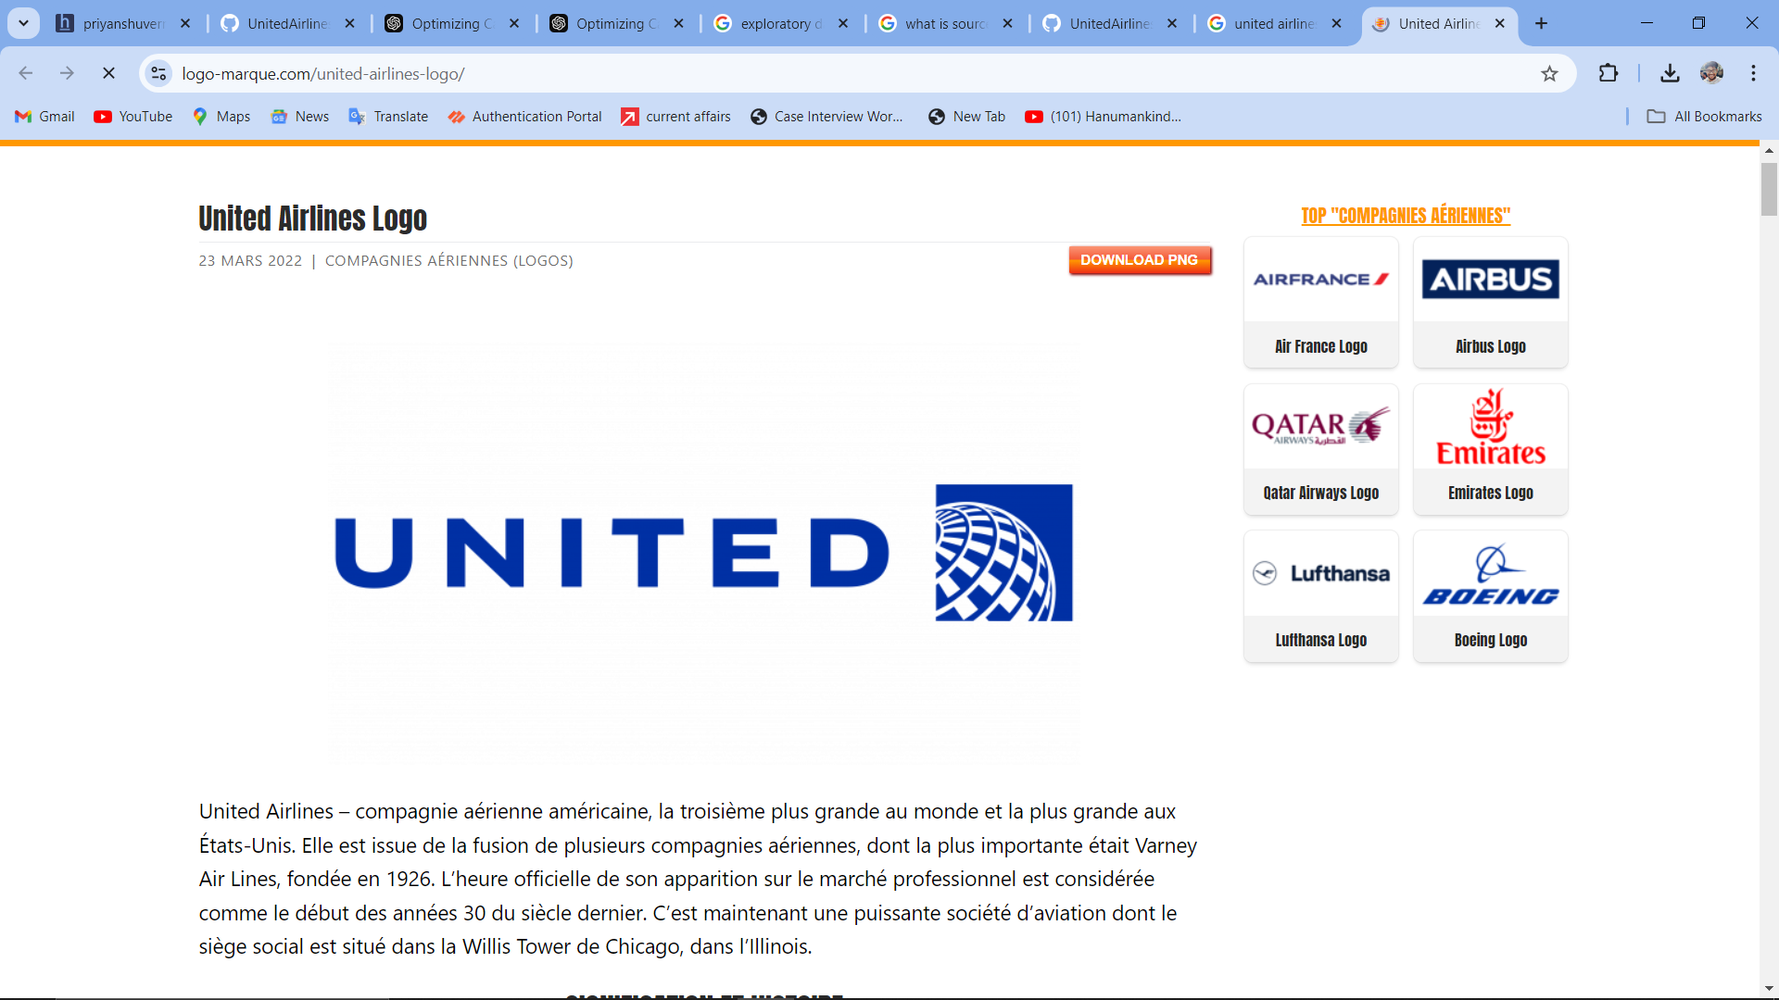
TEAM NAME and MEMBER DETAILS
DTU BOYZ
Priyanshu Verma (2K21/EE/228) Pratham Jaiswal (2K21/EE/218)
THEME:
Optimizing call center performance for United Airlines by improving key metrics like Average Handle Time (AHT) and Average Speed to Answer (AST) to enhance customer satisfaction and operational efficiency.

Slide 3
TABLE OF CONTENT
Sr. No | Topics | Slide Number
1. | Problem Statement | 3
2. | Data Description | 4
3. | Deliverables | 5
4. | Concepts | 6
5. | Data Cleaning | 7
6. | Handling Outliers | 12
7. | Univariate Analysis | 16
8. | Multivariate Analysis | 20
9. | Insights | 28
10. | Deliverable 1 | 30
11. | Deliverable 2 | 34
12. | Deliverable 3 | 37
13. | Conclusion | 39

Slide 4
PROBLEM STATEMENT
The key problems faced in optimizing United Airlines’ call center operations include inefficiencies in both Average Handle Time (AHT) and Average Speed to Answer (AST), which directly affect customer satisfaction and operational efficiency. High AHT suggests that agents may spend excessive time on calls due to unclear procedures, inefficient workflows, or slow systems, limiting the number of calls handled and increasing costs. Long AST, on the other hand, leads to extended wait times for customers, causing frustration and a higher likelihood of call abandonment, which negatively impacts customer loyalty.
Another issue is the suboptimal allocation of resources between human agents and the IVR system. The self-service tools may not be fully leveraged to handle simpler customer queries, leading to overburdening agents with tasks that could be automated. Additionally, unresolved issues during initial calls can lead to escalations, significantly prolonging AHT and reducing overall efficiency.
Process inefficiencies also contribute to these problems, as complex call-handling procedures may delay the resolution of customer inquiries. Furthermore, long AST can result in customers abandoning calls before receiving assistance, leading to reduced resolution rates and dissatisfaction. Finally, the underutilization of real-time data and insights prevents quick interventions to optimize call center operations and improve key metrics like AHT and AST.
Addressing these challenges requires a thorough analysis of call center data to identify the drivers behind long call handling and response times, and the development of strategies to streamline processes and enhance resource allocation between agents and IVR systems.

Slide 5
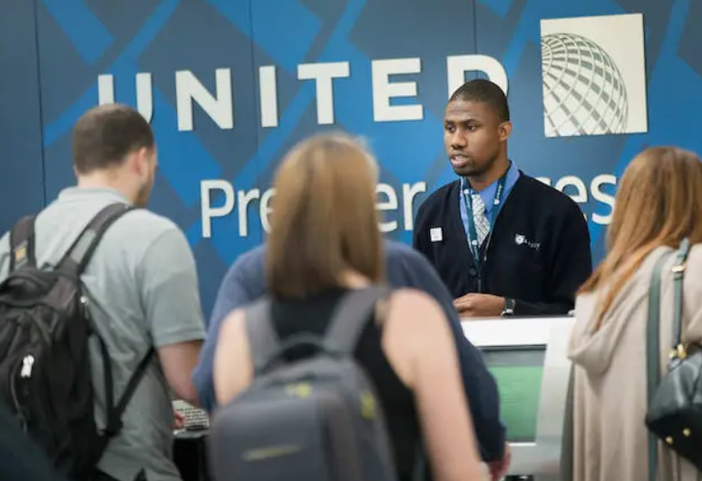
DATA DESCRIPTION
Calls Data : Data of agent, call durations and call id
Customers Data : Data of customer ID, customer tone, etc
Reason Data : Reason why call is placed such as IRROPS, baggage, etc.
Sentiment Statistics : Sentiments of customer data

Slide 6
DELIVERABLES
Comprehensive Data Analysis Report: A detailed analysis of existing call center data to identify inefficiencies, key drivers of long AHT and AST, and trends contributing to these challenges. This report should include visualizations, metrics breakdowns, and insights on customer interactions.
Root Cause Identification: A clear explanation of the main factors contributing to extended AHT and AST, such as workflow bottlenecks, agent performance, IVR inefficiencies, and high call volumes.
Recommendations for Improvement: Specific strategies to optimize both AHT and AST, such as process improvements, enhanced resource allocation, technology upgrades, and improved agent training. This should also include suggestions for better utilization of IVR systems to reduce agent load.
Actionable Roadmap: A step-by-step implementation plan detailing how to execute the recommendations, with timelines, required resources, and expected outcomes. The roadmap should include short-term actions for quick wins and long-term strategies for sustained improvements.

Slide 7
CONCEPTS
ROOT CAUSE ANALYSIS
Root cause analysis (RCA) is a structured process that helps identify the root causes of a problem and develop solutions to prevent it from happening again. RCA is based on the idea that it's more effective to address the underlying causes of a problem than just treat the symptoms.
CORRELATION ANALYSIS
Correlation analysis, also known as bivariate, is primarily concerned with finding out whether a relationship exists between variables and then determining the magnitude and action of that relationship.
NATURAL LANGUAGE TOOLKIT
The Natural Language Toolkit, or more commonly NLTK, is a suite of libraries and programs for symbolic and statistical natural language processing for English written in the Python programming language. It supports classification, tokenization, stemming, tagging, parsing, and semantic reasoning functionalities.
PYTHON STATISTICS
Python's statistics is a built-in Python library for descriptive statistics. You can use it if your datasets are not too large or if you can't rely on importing other libraries. NumPy is a third-party library for numerical computing, optimized for working with single- and multi-dimensional arrays.

Slide 8
EXPLORATORY DATA ANALYSIS [EDA]
Understandi--ng Data
Checking for missing data
Clubbing columns with multiple categories
Checking for outliers
Removing outliers

Slide 9
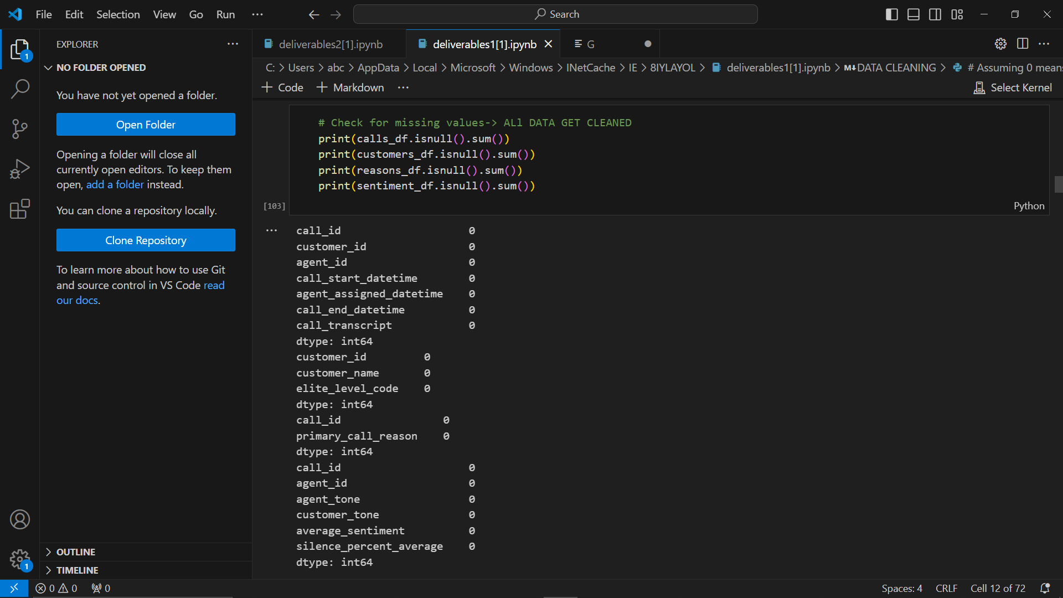
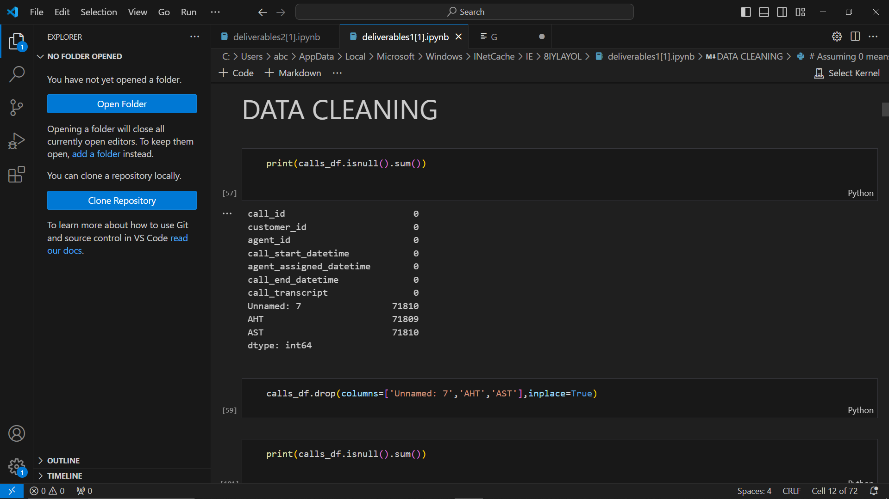
DATA CLEANING
CHECKING FOR MISSING VALUS
BEFORE
AFTER

Slide 10
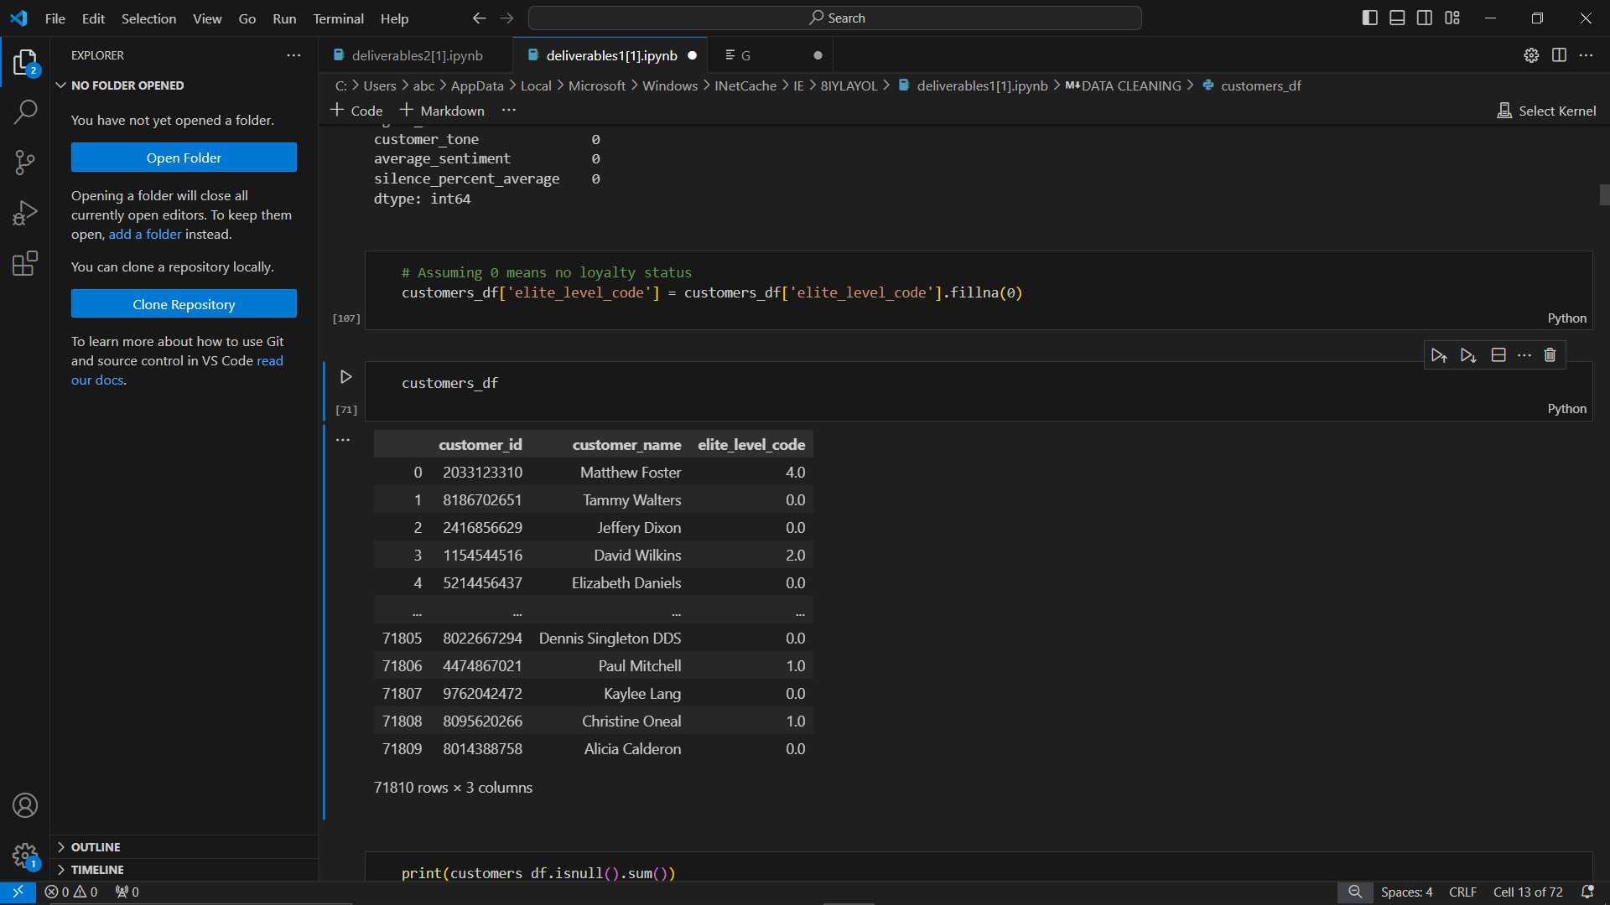
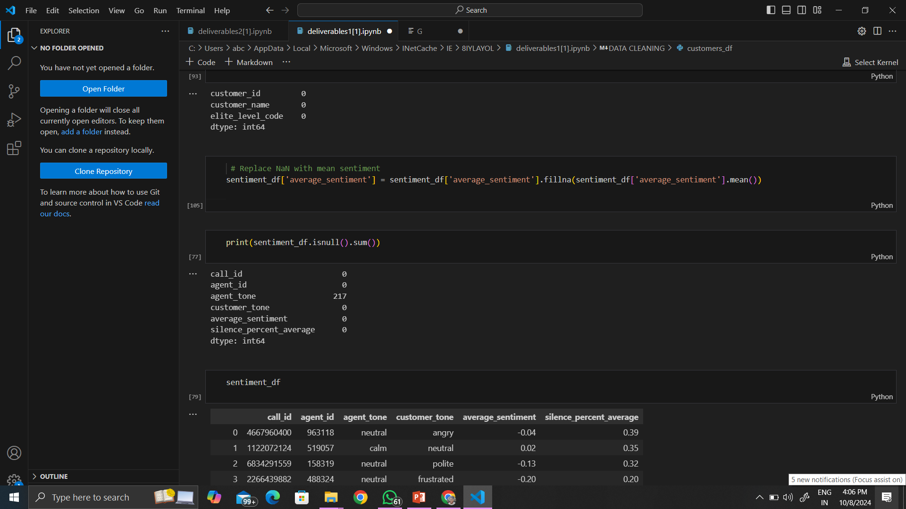
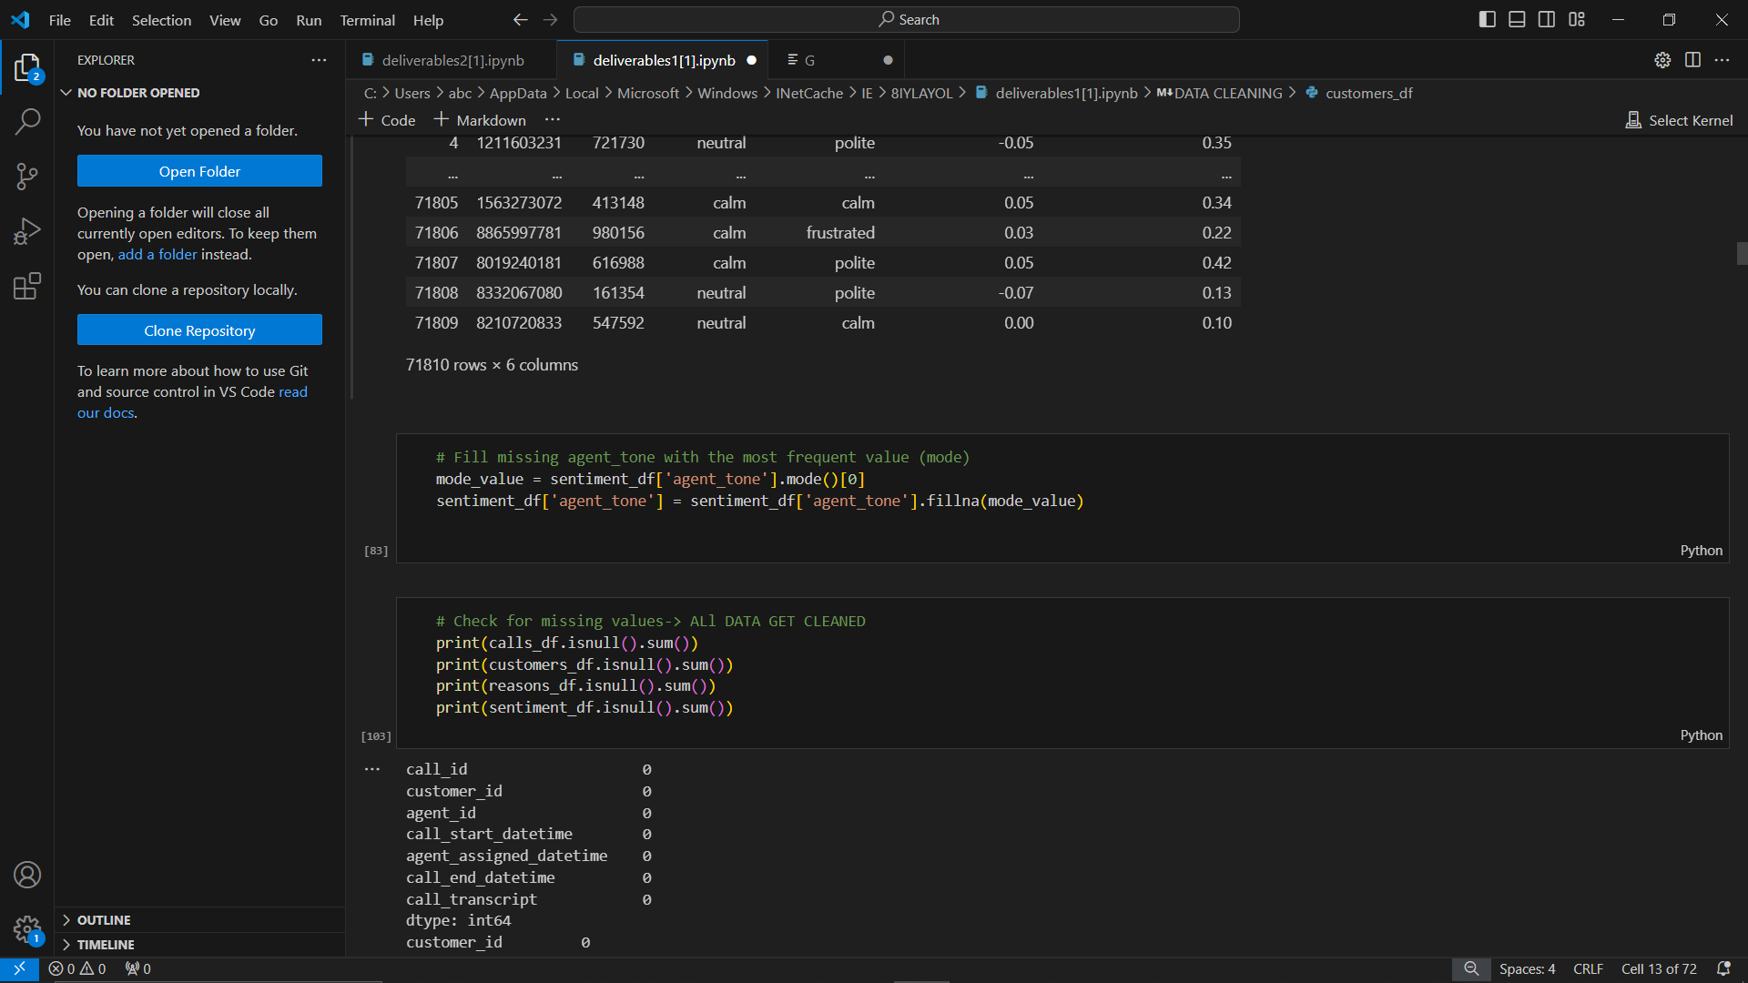
DATA CLEANING
FILLING THE MISSING DATA
REMOVING NaN in sentiments column with mean sentiment
Filling missing agent tone data with mode of agent tone
ASSUMING 0 FOR NO LOYALTY STATUS

Slide 11
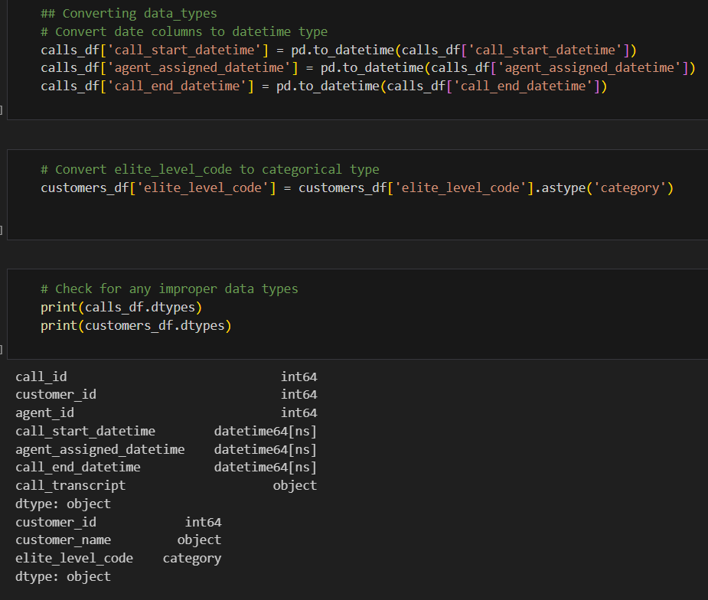
DATA CLEANING
CONVERTING DATA TYPES

Slide 12
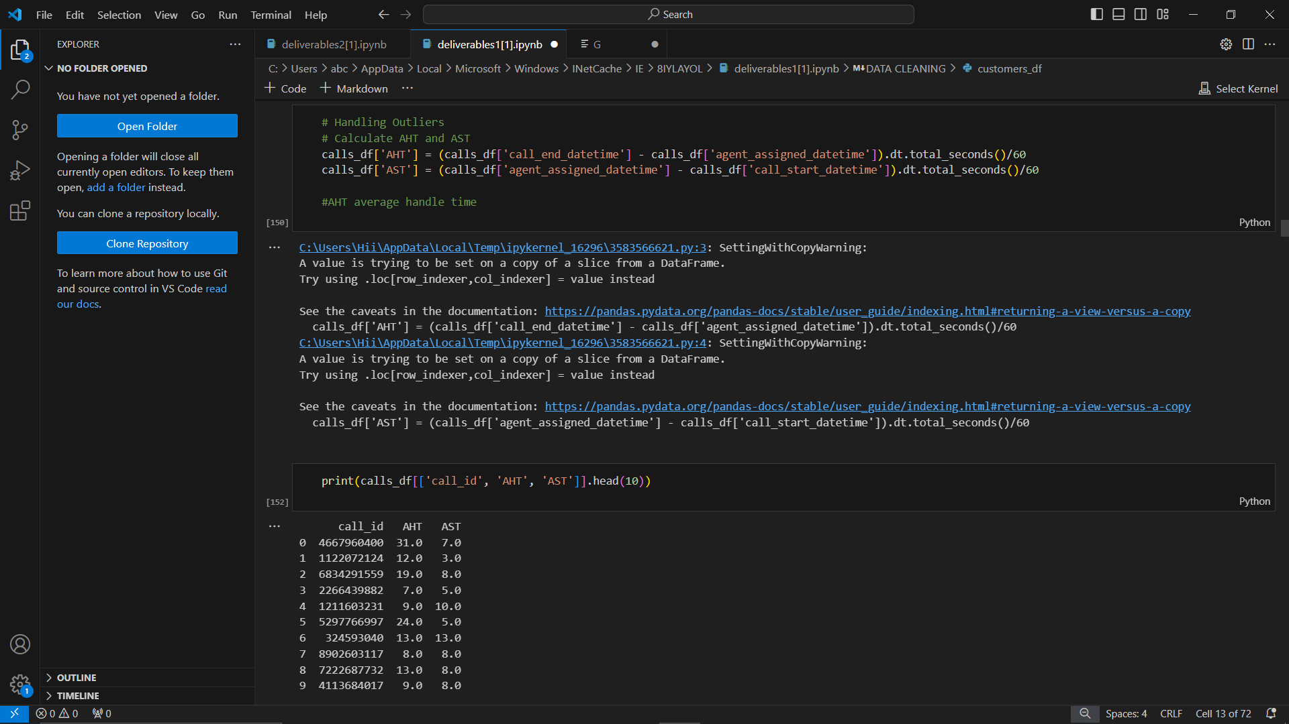
HANDLING OUTLIERS
Calculating Average handling time [AHT] and Average standing time [AST]

Slide 13
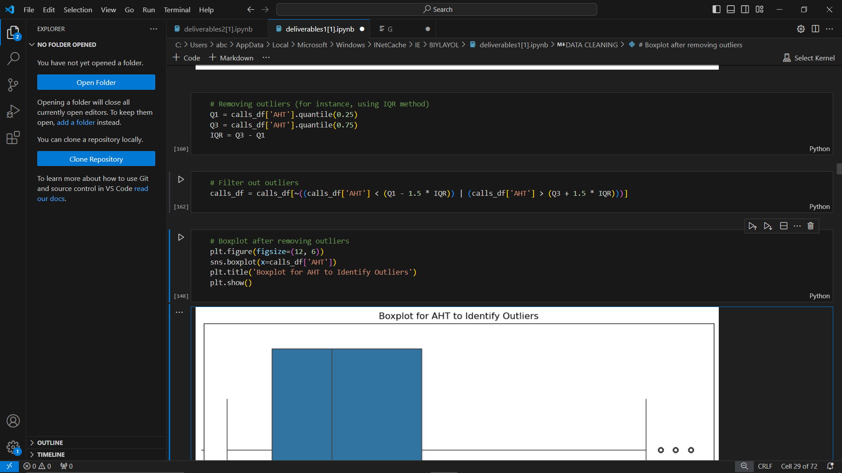
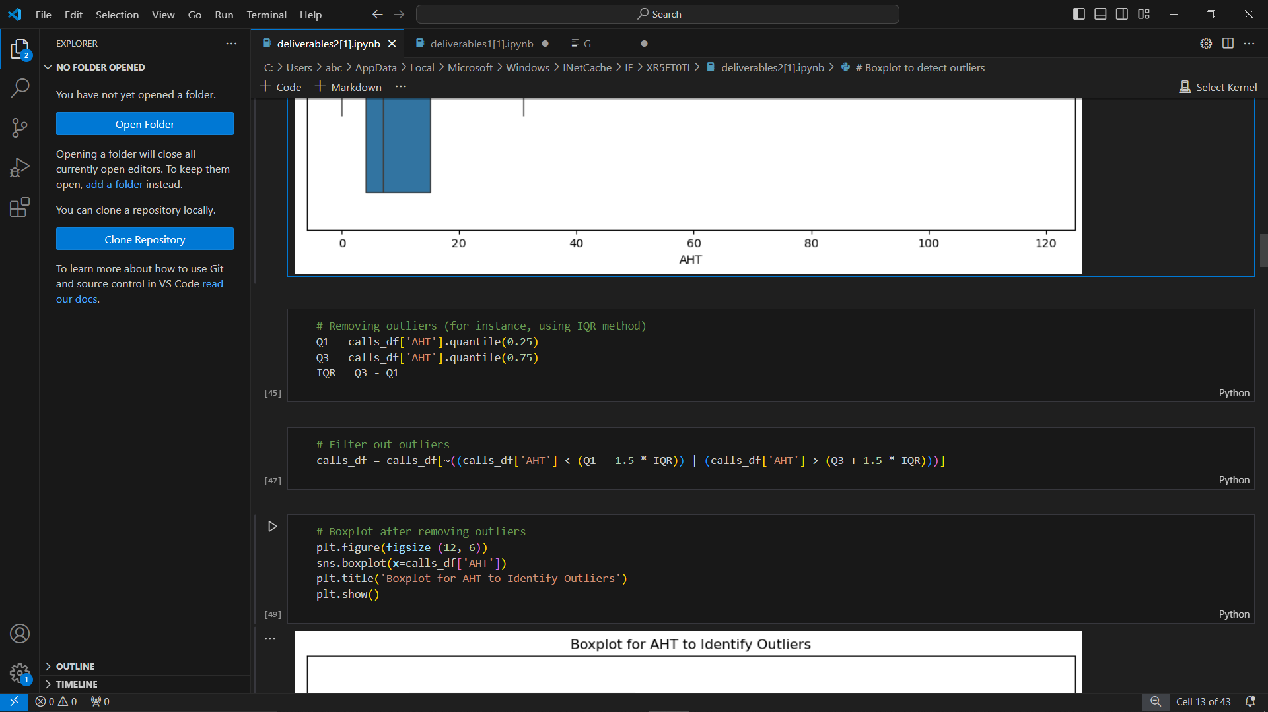
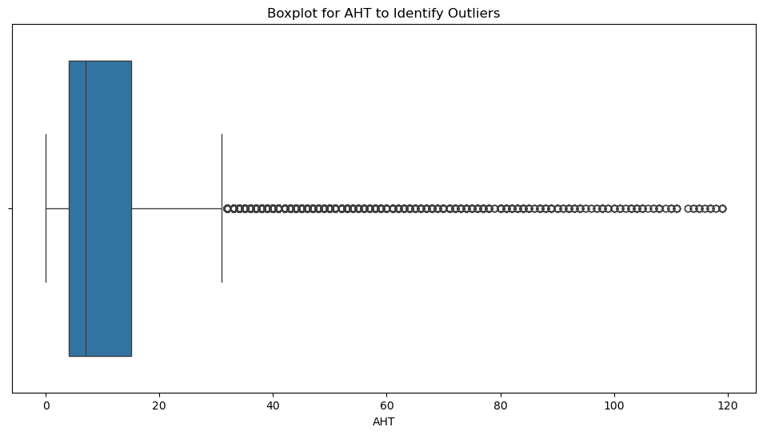
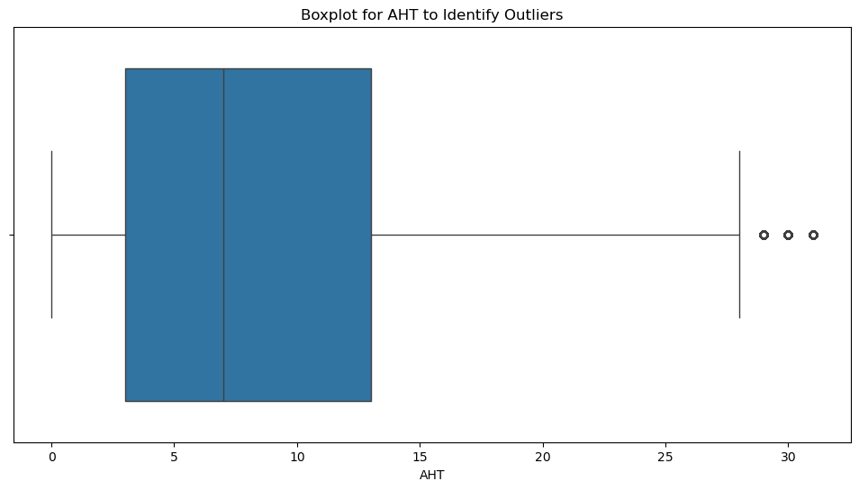
HANDLING OUTLIERS
BOXPLOT to detect outlier in AHT and removing them using IQR method
BEFORE
AFTER

Slide 14
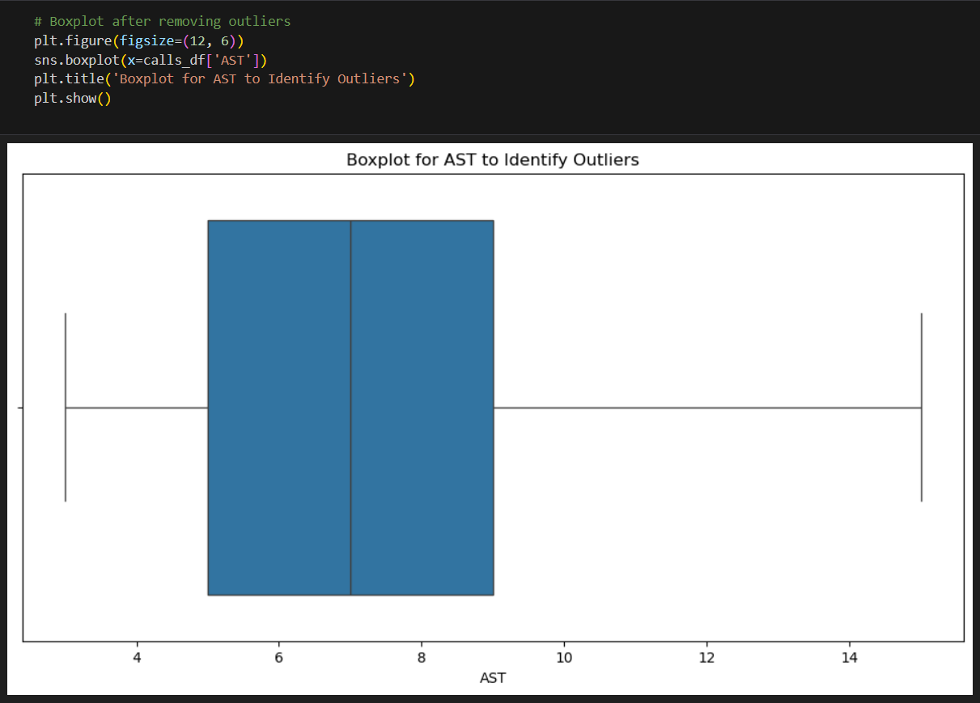
HANDLING OUTLIERS
BOXPLOT to detect outlier in AST and removing them using IQR method

Slide 15
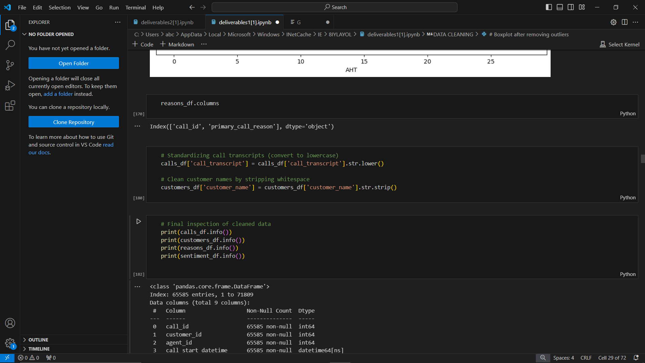
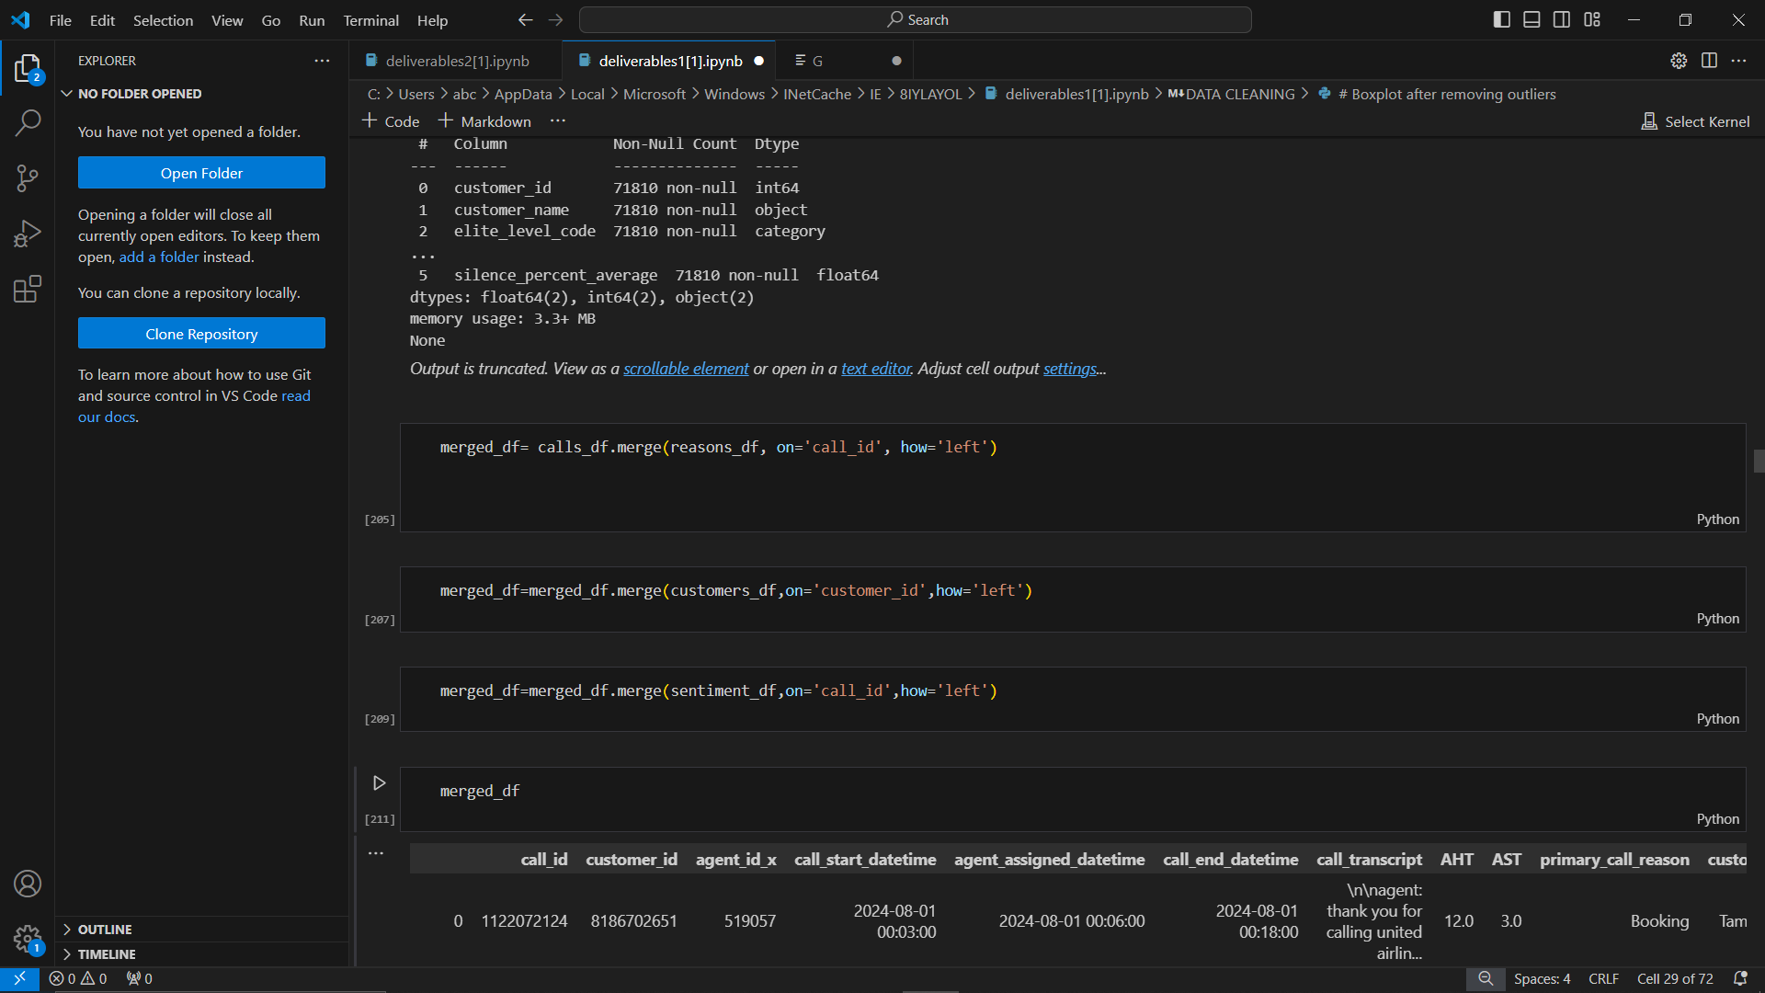
MERGING COLUMN AND REMOVING WHITESPACES

Slide 16
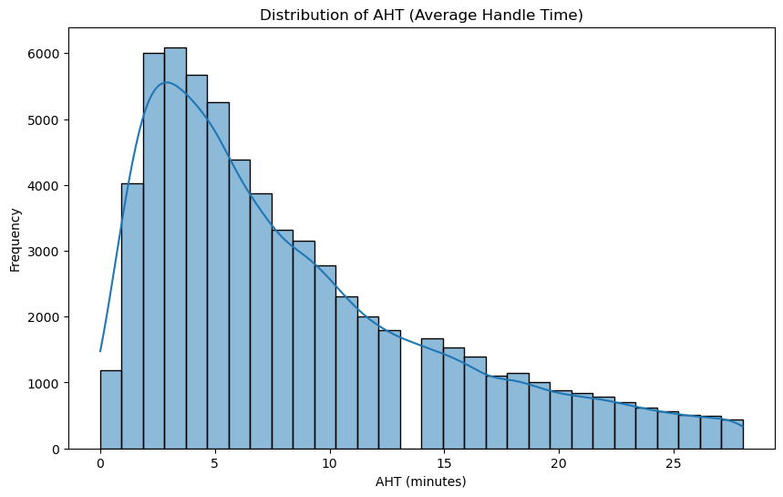
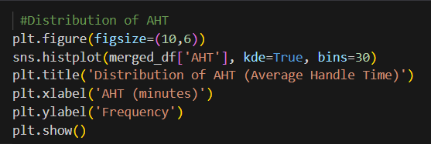
UNIVARIATE ANALYSIS
Distribution of AHT with respect to Frequency

Slide 17
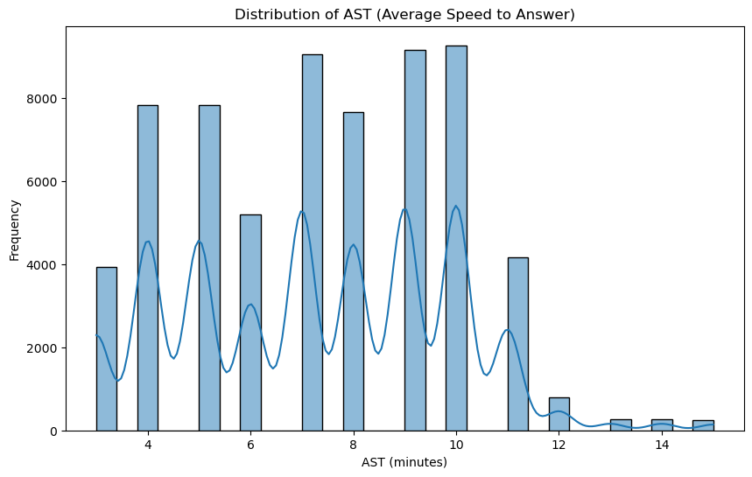
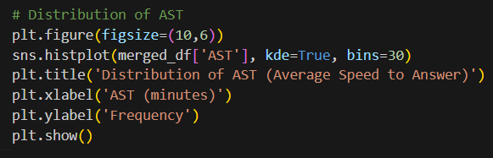
UNIVARIATE ANALYSIS
Distribution of AST with respect to Frequency

Slide 18
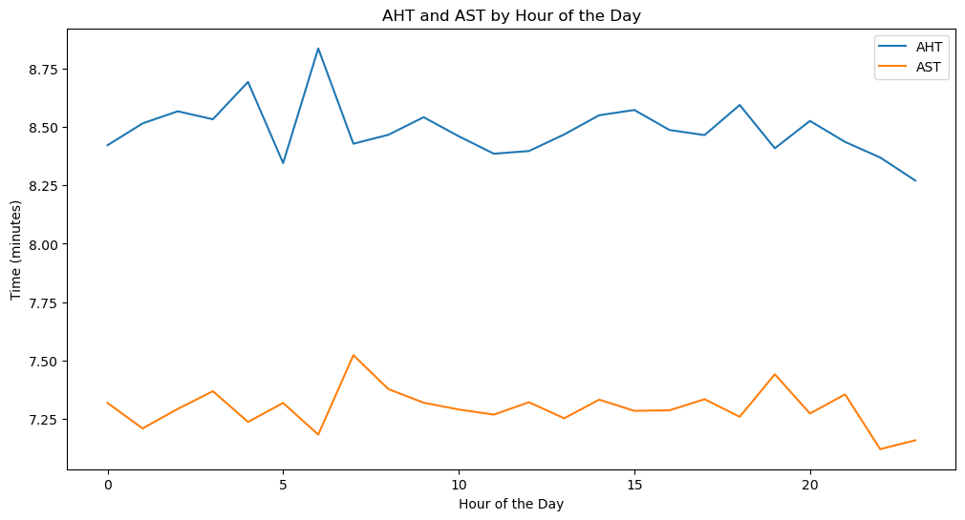
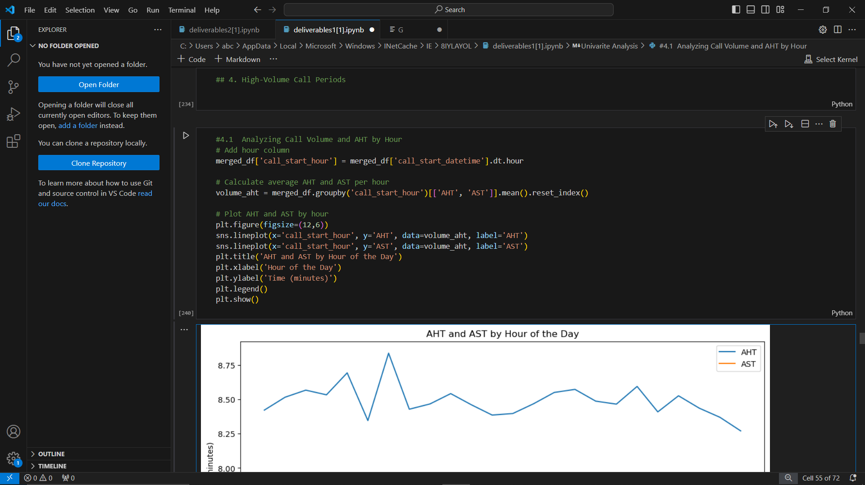
UNIVARIATE ANALYSIS
Analysis of average call duration with respect to hour of the day

Slide 19
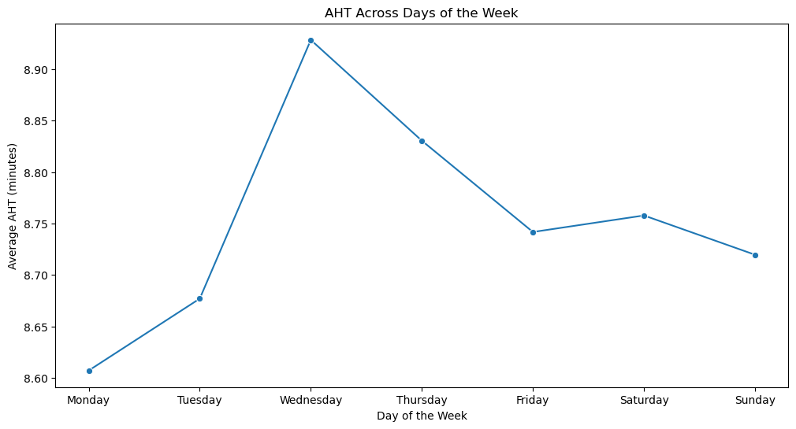
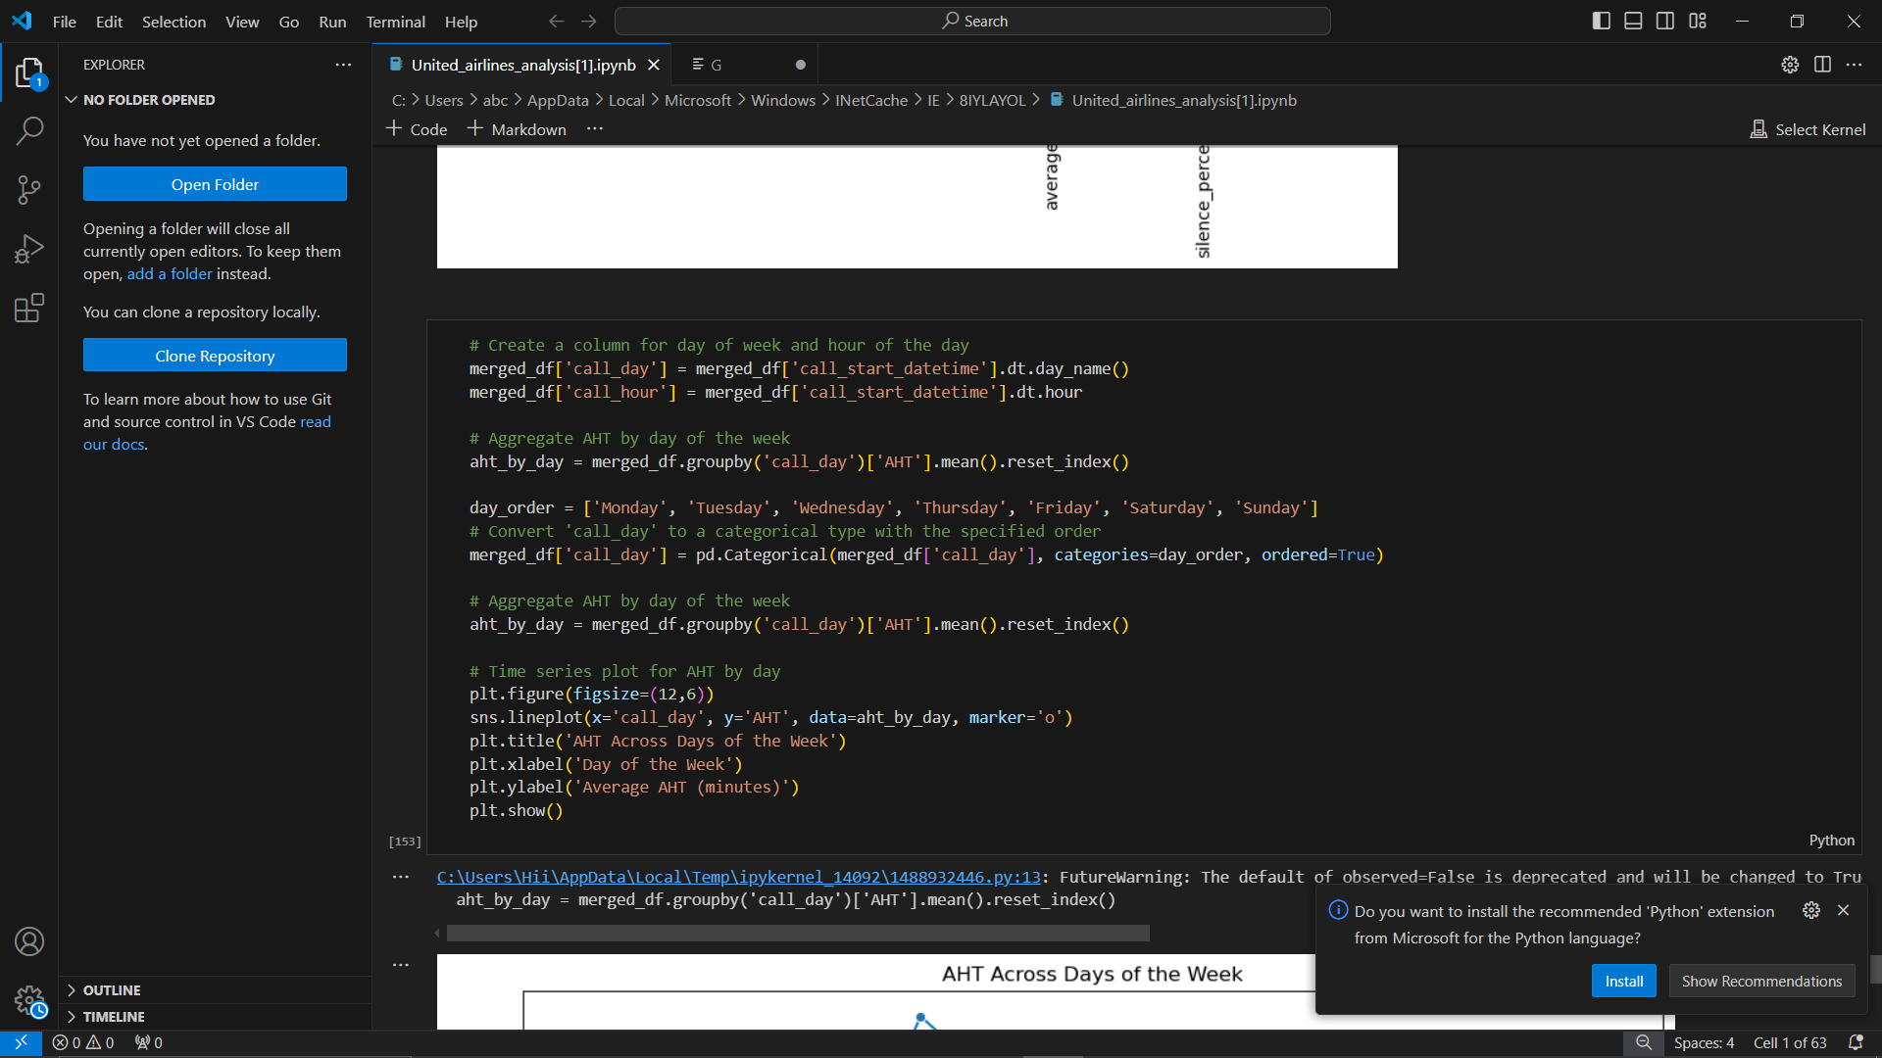
UNIVARIATE ANALYSIS
AHT across days of the week

Slide 20
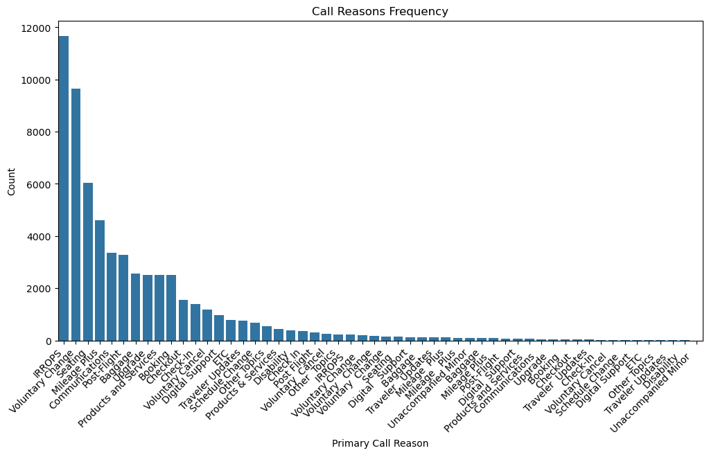
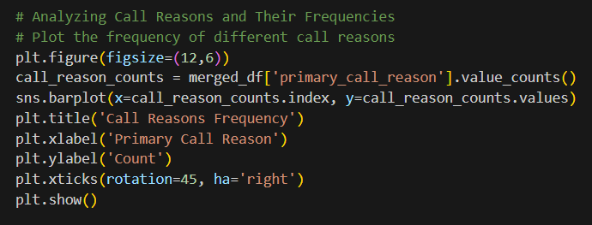
MULTIVARIATE ANALYSIS
Distribution of Call Reason with respect to Frequency

Slide 21
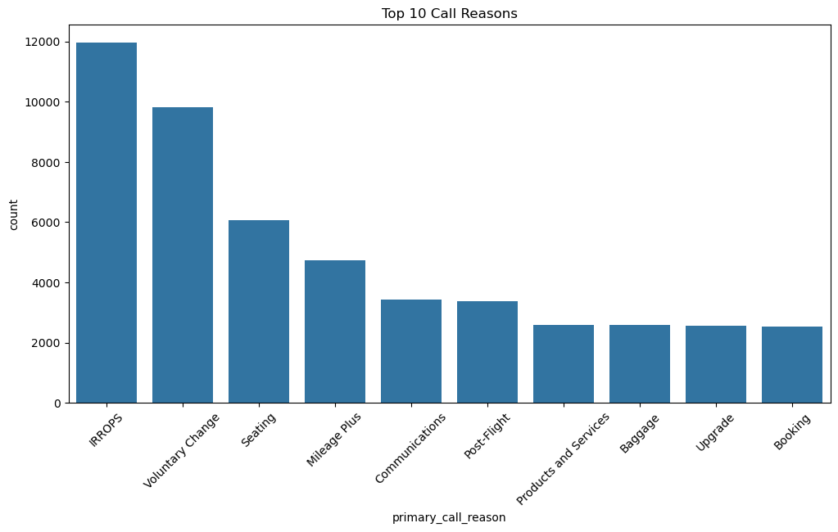
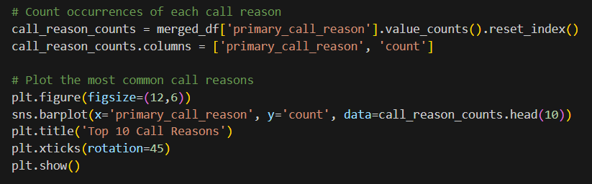
MULTIVARIATE ANALYSIS
Top call reasons

Slide 22
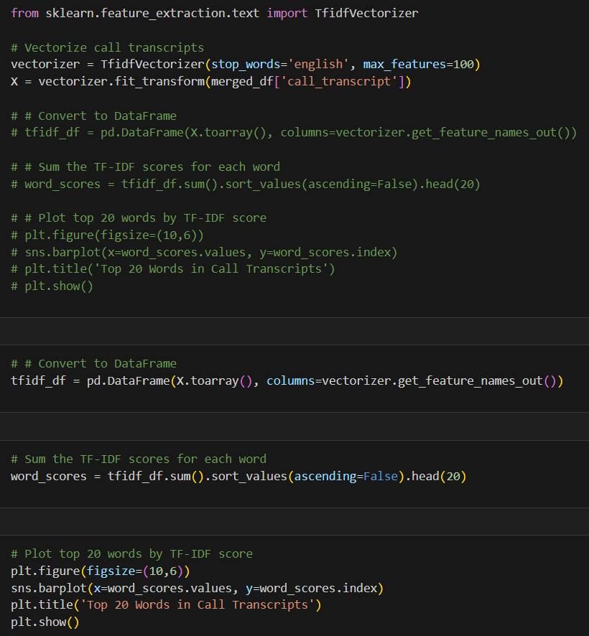
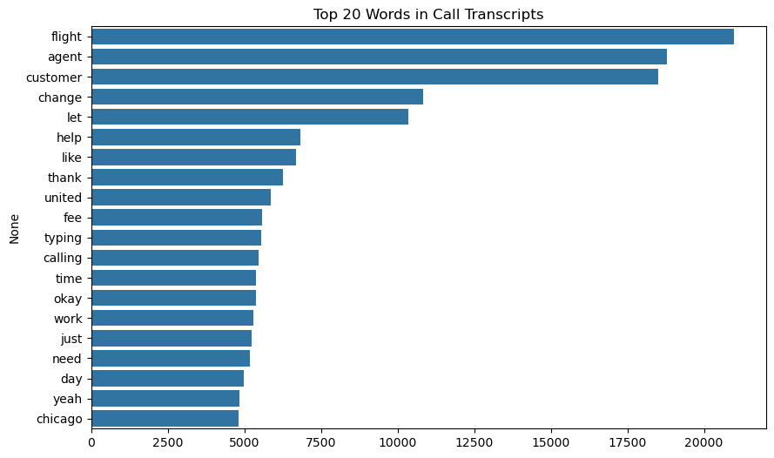
MULTIVARIATE ANALYSIS
Top 20 words in call transcripts

Slide 23
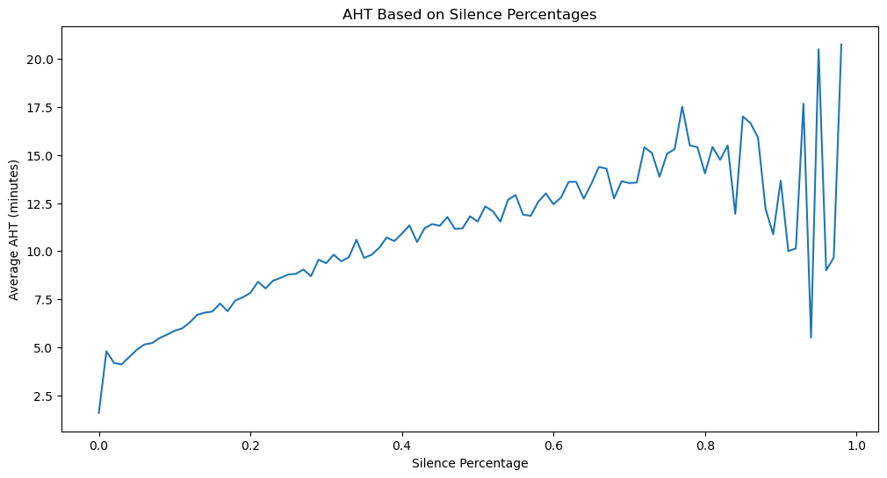
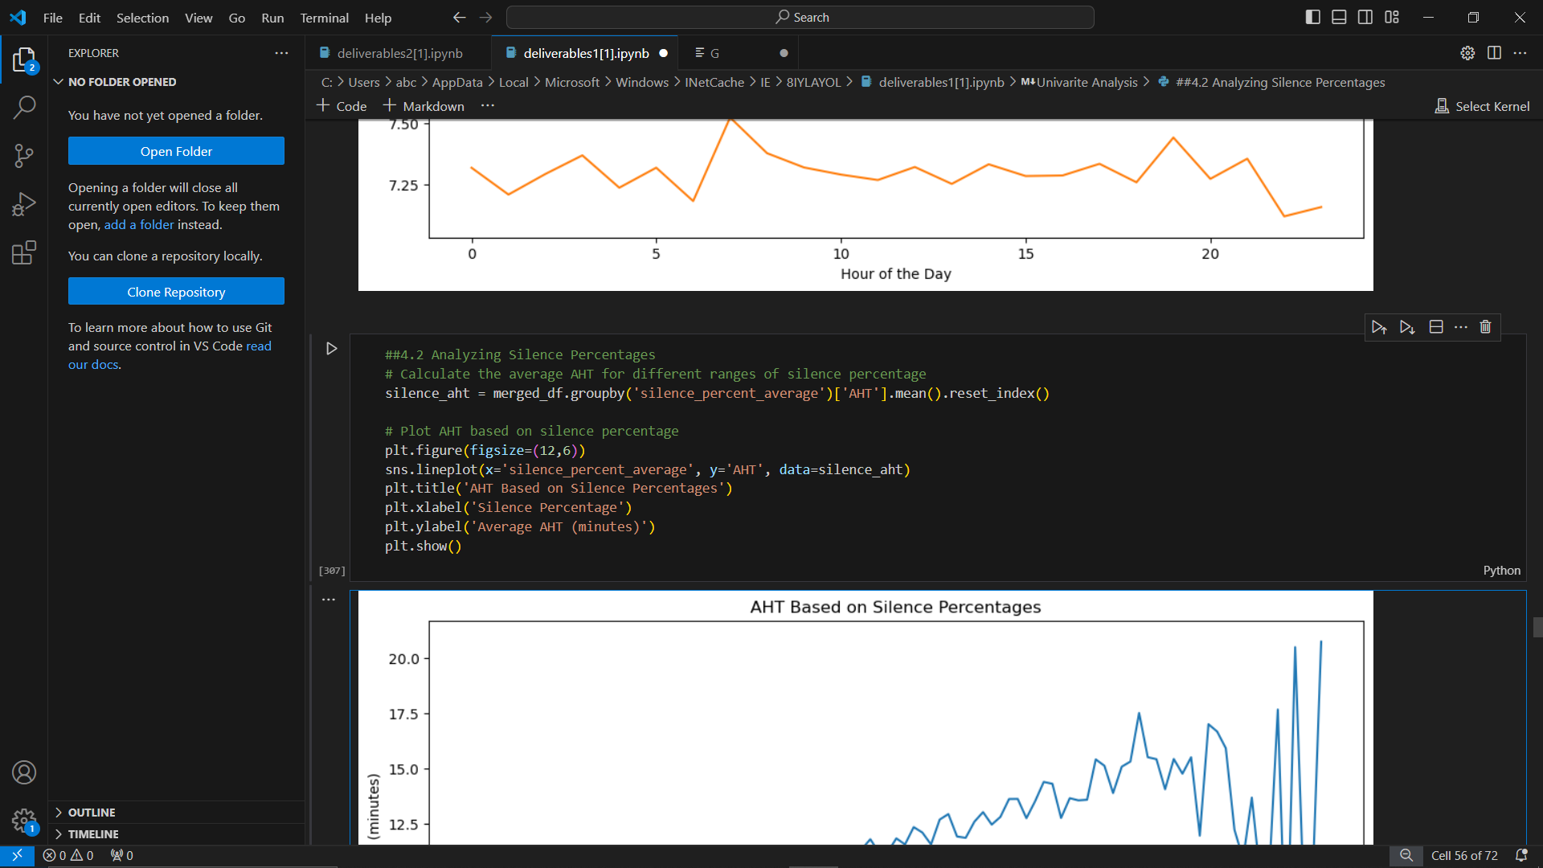
MULTIVARIATE ANALYSIS
Impact of Silence percentage on AHT

Slide 24
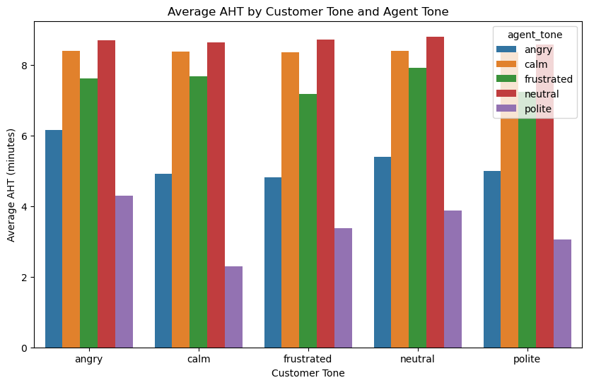
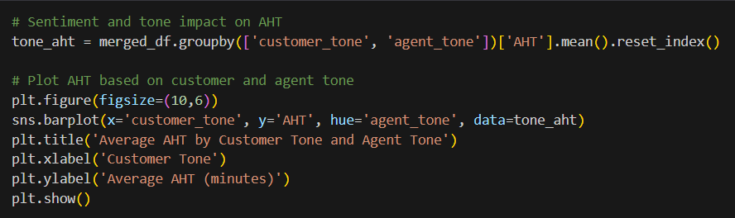
MULTIVARIATE ANALYSIS
Plot of Sentiments and tone impact on AHT

Slide 25
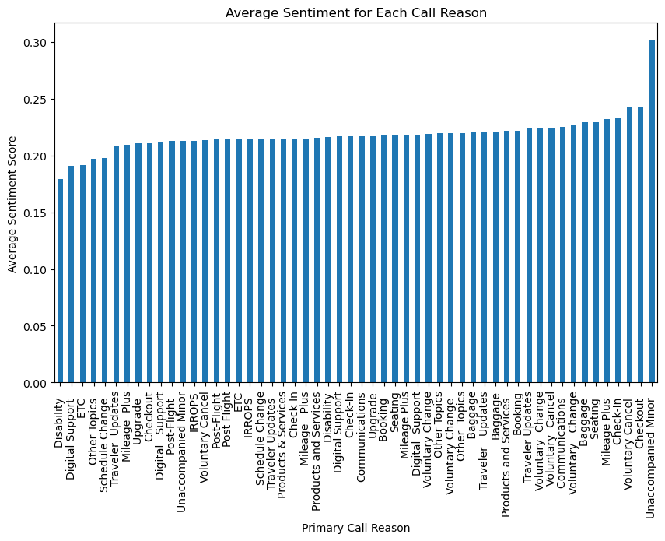
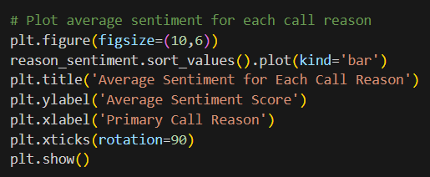
MULTIVARIATE ANALYSIS
Average Sentiment for each call reason

Slide 26
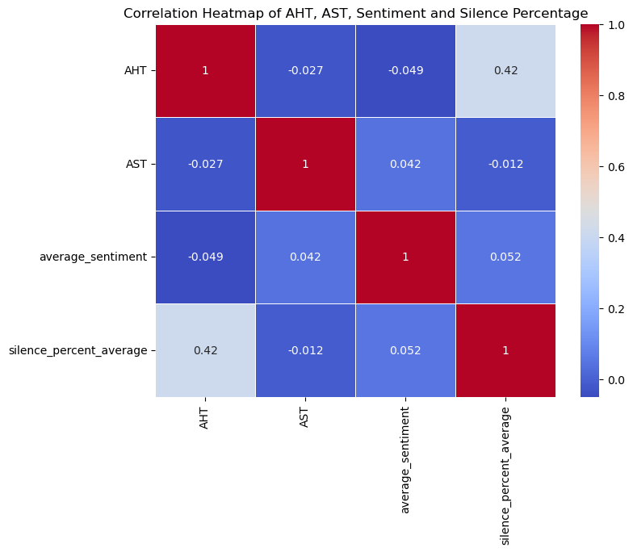
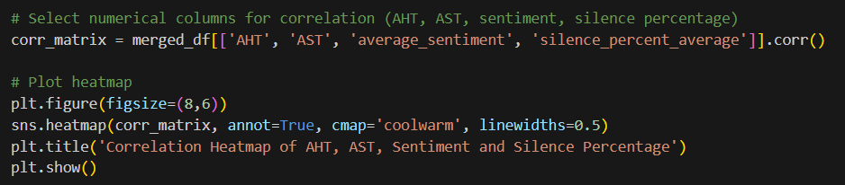
MULTIVARIATE ANALYSIS
Correlation Heatmap of AHT, AST, Sentiment and Silence Percentage

Slide 27
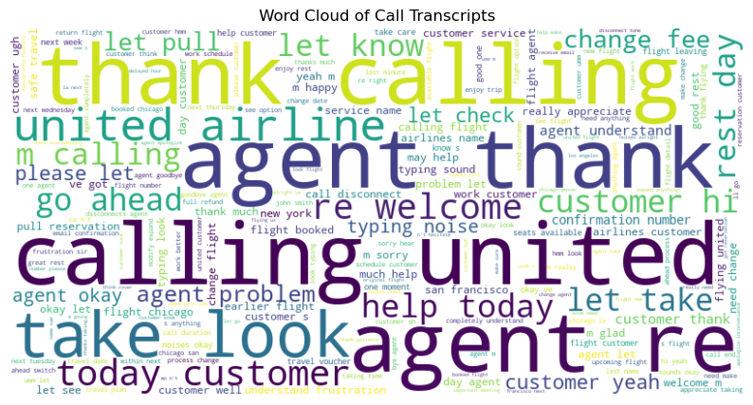

Slide 28
INSIGHTS
1. Most of the calls are handled [AHT] within 2 to 5 minutes.
3. Most of the calls are picked [AST] within 10 minutes
4. Most of the calls are for the reason IRROPS, VOLUNTARY CHANGE, SEATING, MILEAGE PLUS, COMMUNICATION, POST FLIGHT
5. Most of the calls are between neutral agent and neutral customer
6. When the customer as well as agents are polite issues are solved in less AHT
7. When the customer is calm and agent is polite AHT is least [2 min]
8. When the agent is calm, then AHT does not depends on mood of the customer
9. Most of the calls are between 6 AM and 7 AM and between 6PM and 10 PM
10. AHT increases with the increase in silent percentage of customer
11. AHT is most on Thursday and Wednesday while least on Monday and Tuesday
12. Sentiment analysis shows that people are more sentimental towards check in and check out
2. About 1000+ calls requires 20+ minutes

Slide 30
Factors Contributing to Extended Call Durations:
Agent Performance: The analysis shows that agent performance significantly affects call durations. Most calls are handled within 2 to 5 minutes, but about 1,000+ calls require over 20 minutes. Calm and polite agents are able to resolve issues more quickly. Specifically, when agents remain polite and calm, Average Handle Time (AHT) is reduced, especially when paired with calm customers (AHT as low as 2 minutes). However, agent politeness alone can reduce AHT even if the customer’s mood varies.
Call Types: The most frequent call types include IRROPS (11,000 calls), Voluntary Changes (10,000 calls), Seating (6,000 calls), Mileage Plus (4,200 calls), and other communication-related issues. These types of calls influence AHT, with some taking longer to resolve due to their complexity, such as IRROPS and voluntary changes.
Sentiments: The sentiment analysis reveals that AHT is affected by customer sentiment and agent-customer interaction. When both the customer and agent maintain neutral or polite tones, AHT is reduced. However, when customers remain silent for large portions of the call (80%-90% silence), AHT increases significantly to 15-18 minutes. Sentiment also plays a role in calls related to check-ins and check-outs, where customers show more emotional engagement.

Slide 31
Key Drivers of Long AHT and AST During High Call Periods:
Call Volume Peaks: AHT is highest during periods of increased call volume, specifically between 6 AM and 7 AM and 6 PM and 10 PM. These peak periods lead to delays in Average Speed to Answer (AST) and a subsequent increase in AHT due to high traffic and workload.
Call Silence: High silent percentages in calls are a strong driver of long AHT. Calls with minimal silence (0%) have AHT reduced to 5 minutes, while calls with 80%-90% silence have an AHT of 15-18 minutes.
Mid-week Peaks: AHT is notably higher on Wednesdays and Thursdays but lower on Mondays and Tuesdays.

Slide 32
Percentage Difference Between Average Handling Time for Most Frequent and Least Frequent Call Reasons:
Comparing the most frequent (IRROPS) and least frequent (Mileage Plus) call reasons, there’s a significant difference in AHT. On average, more frequent call reasons such as IRROPS tend to have longer AHT due to complexity, while less frequent calls like Mileage Plus are resolved faster, indicating a percentage difference in AHT between these two categories.
Percentage difference in AHT between the most and least frequent call reasons: 227.91%

Slide 33
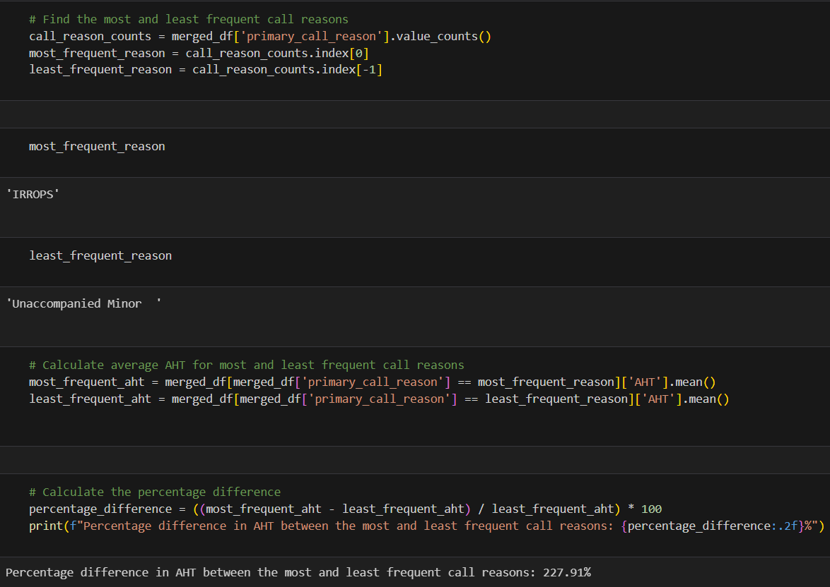
Percentage Difference Between Average Handling Time for Most Frequent and Least Frequent Call Reasons:

Slide 34
Issues Solvable by IVR and How to Solve Them:
IRROPS (Irregular Operations): Insights: Customers often inquire about flight disruptions due to weather or operational issues. These queries can overwhelm agents during irregular operations. Solution: Enhance IVR to provide automated updates on flight delays, cancellations, and rebooking options. Integrate real-time data from the airline’s flight management system to offer self-service for rebooking or refunds.
Voluntary Change: Insights: Many calls are related to customers voluntarily changing flights or booking details. Handling these through agents increases AHT unnecessarily. Solution: The IVR system can provide options to modify bookings, change flight dates, and seats. A self-service portal integrated into the IVR can allow customers to make changes on their own without agent intervention.
Seating: Insights: Customers frequently call to change or inquire about seat assignments, which can be easily automated. Solution: Offer real-time seat selection via the IVR. Customers should be able to view available seats and change their seating preferences through an automated system, especially for routine seat changes or upgrades.
Mileage Plus: Insights: Loyalty program inquiries like account balance, point redemption, or status upgrades are common but simple enough for self-service. Solution: Allow IVR to handle Mileage Plus account balance checks, point redemption, and upgrade requests. Offer automated solutions for these queries to reduce agent workload.

Slide 35
Issues Solvable by IVR and How to Solve Them:
Baggage:
Insights: Baggage-related queries often involve tracking or reporting lost baggage, which could be automated.
Solution: Introduce a baggage tracking feature through the IVR, where customers can input their baggage tags and get real-time updates on the status. Automate lost baggage reports with a clear follow-up process to keep customers informed.
Booking:
Insights: Basic booking inquiries like checking flight availability or fares can be handled through IVR.
Solution: The IVR can provide flight booking, availability checks, and fare information without the need for an agent. It can guide customers through booking steps, confirming payments, and providing flight options.
Check-ins:
Insights: A high number of customers call to check-in, even though online and mobile check-ins are available.
Solution: Provide a straightforward IVR pathway for self-check-ins. Integrate mobile boarding pass issuance and seat selection through IVR, removing the need for agents to intervene.
Travel Updates:
Insights: Travel updates like gate changes, flight status, or weather delays can be provided without agent assistance.
Solution: Use the IVR to automatically inform customers about gate changes, weather updates, and other travel-related updates in real-time, which can reduce call volume to agents during disruptions.

Slide 36
Reasons and way to decrease AHT
Reasons for Calls:
The most common call reasons include IRROPS, Voluntary Changes, Seating, Mileage Plus, and Post-Flight Communication. These call reasons account for the majority of incoming call traffic, indicating their importance in improving self-service pathways.
Reduce Manual Tagging Efforts:
Automating the call reason identification process using Natural Language Processing (NLP) tools can help reduce the need for manual tagging. By analyzing the most frequent words in call transcripts, such as "flight", "change", and "agents", NLP models can be trained to automatically classify call reasons.
Ensuring Customers are Directed to Appropriate Resources:
To reduce AHT and improve service, the IVR system should be designed to direct customers to the appropriate self-service or agent-based resources based on their identified reason for calling. For example, customers seeking flight changes should be directly routed to automated systems that can handle these requests without involving human agents.

Slide 37
Recommendations for United Airlines
1. Expand IVR Self-Service Capabilities
Data Insight:
High call volumes are related to routine issues like IRROPS, voluntary changes, seating, and Mileage Plus. These call types can be automated through the IVR system.
Recommendation:
Automate Common Queries: Expand the IVR system to handle high-volume, routine inquiries such as seating arrangements, flight status updates, booking changes, and Mileage Plus account queries.
Real-Time Integration: Integrate real-time flight data and account information into the IVR system to enable customers to resolve issues like flight cancellations or loyalty status inquiries without agent intervention.
Impact:
This will significantly reduce Average Handle Time (AHT) and Average Speed to Answer (AST) by preventing simple issues from reaching agents, thus optimizing the use of resources.
2. Optimize IVR for Peak Call Periods
Data Insight:
Most call occurs between 6 AM to 7 AM and 6 PM to 10 PM, leading to higher AHT and AST during this time period.
Recommendation:
Dynamic IVR Flow: Introduce an adaptive IVR system that prioritizes self-service and automation during peak periods. For instance, during high traffic, the IVR can preemptively suggest options for resolving common issues like rebooking or checking flight status.
Predictive Call Routing: Use historical data to predict peak call periods and pre-route calls with simple solutions to the IVR, allowing agents to focus on more complex issues.
Impact: This will reduce call congestion during peak hours and improve customer satisfaction and reduced call abandonment.
3. Implement Sentiment-Based Routing
Data Insight:
Calls where both the customer and agent are polite result in shorter AHT (as low as 2 minutes). When silence is high (80-90%), AHT extends to 15-18 minutes.
Recommendation:
Sentiment Detection in IVR: Implement sentiment analysis within the IVR system to assess customer mood (e.g., frustration, calmness) before transferring to an agent. Calls that exhibit high levels of frustration can be routed to more experienced agents, while routine queries can be handled by automated systems or less experienced agents.
Silence Detection: Integrate silence detection in the IVR system to prompt customers during periods of inactivity, which can help move the conversation forward and prevent prolonged silence.
Impact: This will reduce AHT by ensuring that the right calls are directed to the right agents and minimizing time spent on unproductive interactions.

Slide 38
Recommendations for United Airlines
4. Leverage Data to Personalize IVR Paths
Data Insight:
Frequent call reasons like IRROPS, voluntary changes, and baggage tracking can be automated, but customers prefer personalized service.
Recommendation:
Customer Profile Integration: Use customer data to personalize IVR interactions. For instance, if a customer frequently travels with United, the IVR can preemptively offer Mileage Plus information, booking changes, or status updates.
Contextual Self-Service: Automatically suggest the most likely self-service options based on the customer’s past interactions (e.g., if the customer recently booked a flight, offer options related to check-in or flight changes).
Impact:
Personalized IVR interactions will reduce AHT and improve customer satisfaction by offering solutions that are directly relevant to each customer.
5. Focus on Automating Solutions for Specific Call Reasons
Data Insight:
Most calls are for issues like IRROPS, seating, voluntary change, and travel updates, which can be addressed through self-service.
Recommendation:
Automate Baggage Tracking: Introduce an automated baggage tracking system through the IVR, allowing customers to enter their baggage tag number and receive real-time updates on baggage location.
Enhance Flight Status & Schedule Change Features: Automate flight status and schedule change notifications, allowing customers to receive updates and make adjustments through the IVR without agent assistance.
Upgrade and Cancellation Options: Provide self-service for voluntary cancellations and upgrade requests, reducing the need for agent intervention in these frequent requests.
Impact: Automating these solutions will not only reduce agent workload but also provide a seamless experience for customers seeking routine information.
6. Analyze and Optimize IVR Paths Based on Silence and Sentiment
Data Insight:
AHT increases with high silence percentages in customer interactions.
Recommendation:
Monitor Silence in IVR Paths: Track customer silence in the IVR system to identify where customers may be confused or stuck. Use this data to improve IVR prompts and reduce periods of inactivity.
Proactive Prompts: Introduce more proactive IVR prompts to guide customers through self-service options, reducing the need for long pauses or escalation to agents.
Impact:
Reducing customer silence and frustration in the IVR system will decrease AHT and ensure smoother customer interactions.

Slide 39
CONCLUSION
By leveraging data-driven insights, United Airlines can significantly enhance its call center performance by expanding self-service options, optimizing IVR pathways, and personalizing customer interactions. These changes will reduce AHT, AST, and agent workload while improving overall customer satisfaction and operational efficiency.

Slide 40
THANK YOU

